Slide 2
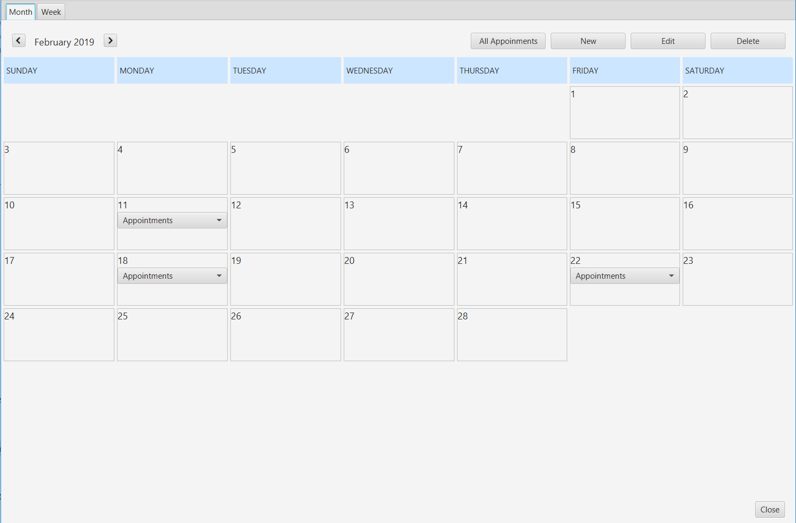
GridPane
ComboBox
VBox
Label

Slide 3
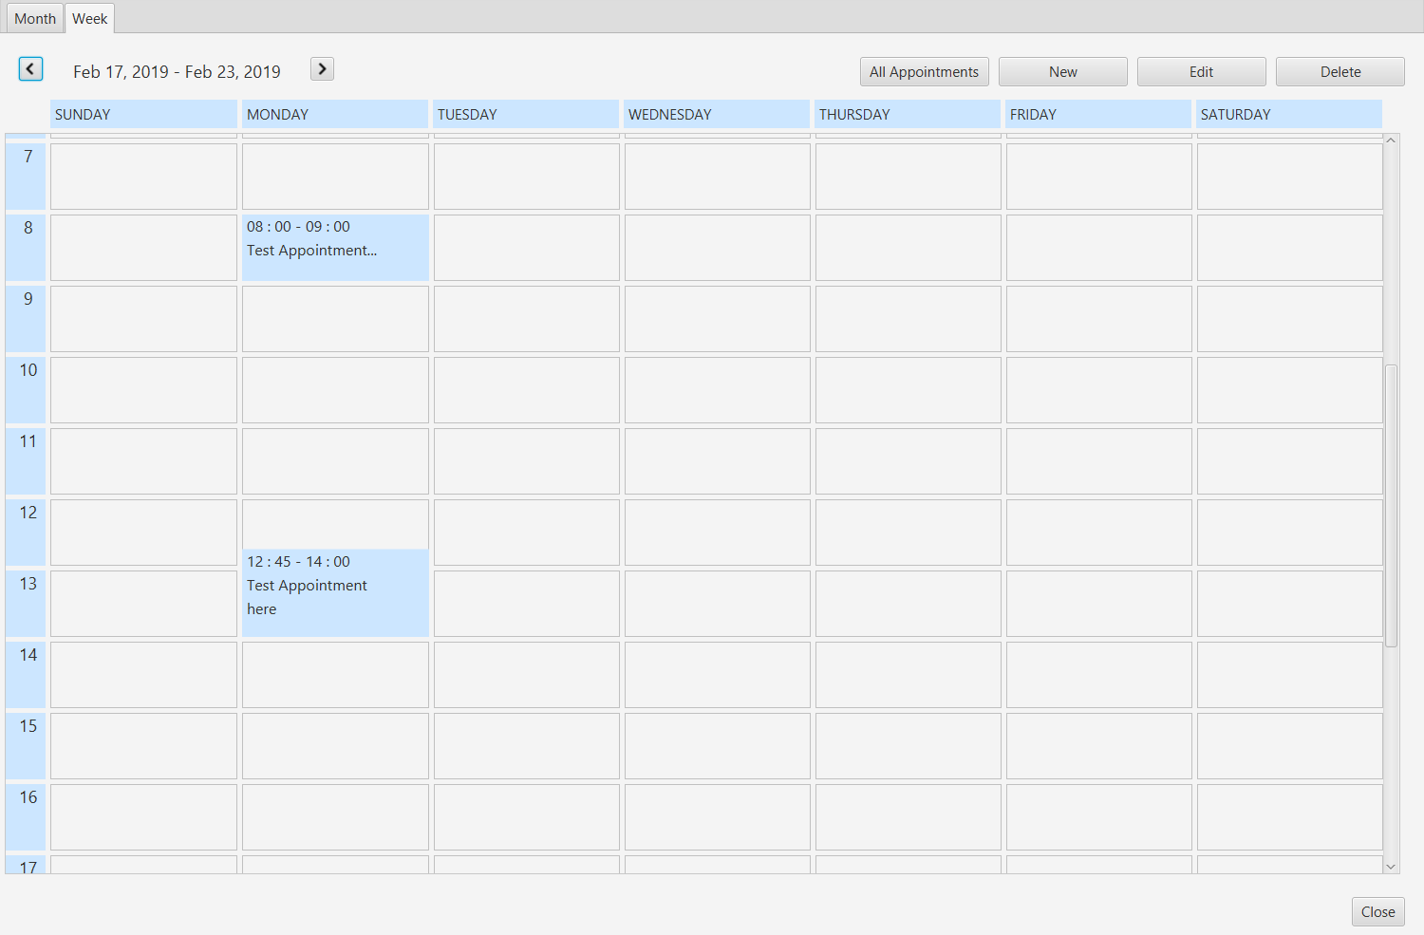
How to display appointments with overlapped time between grids?

Slide 4
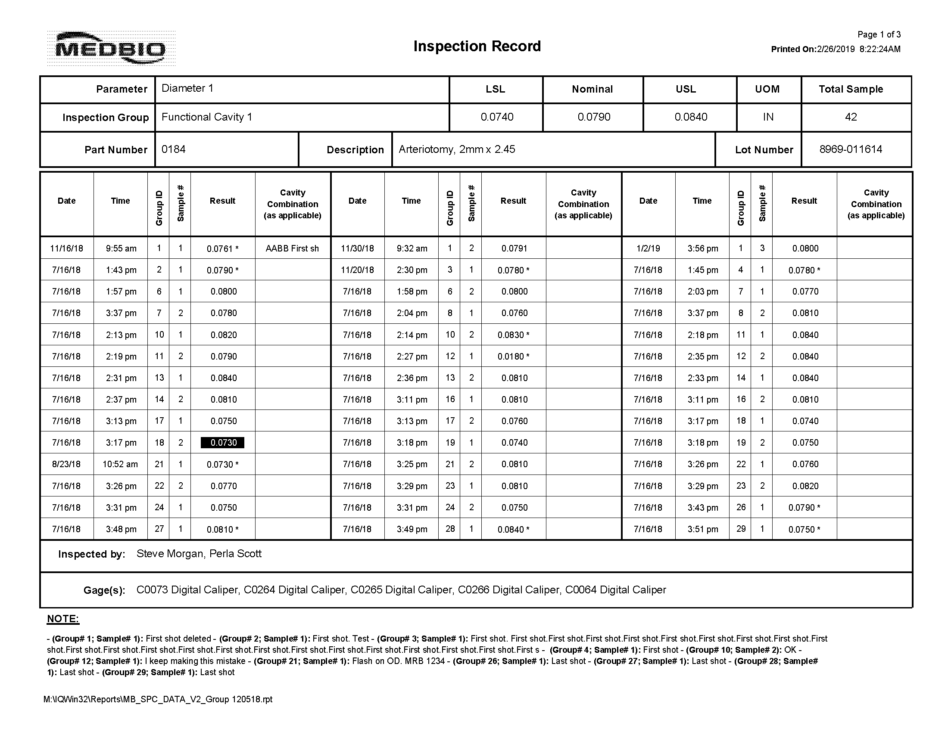
Conditional formatting to highlight nonconforming data

Slide 5
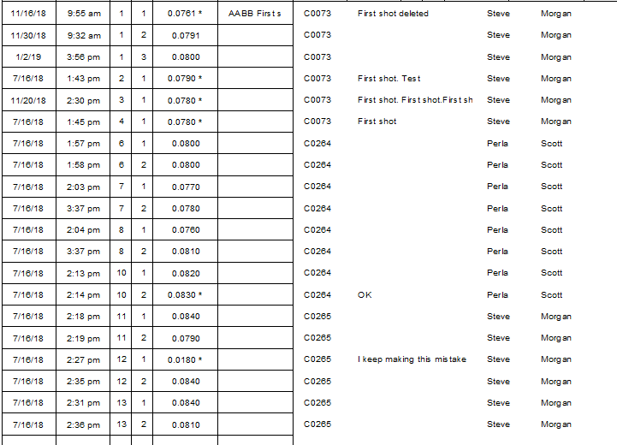
Additional columns

